Slide 1
BRIGHT
Move towards the light
Team Zahlen
Sean Halloran
Stone Cleven

Slide 2

The Puzzle
Objective:
To swap all the tiles to white
Click on the tiles to toggle multiple at a time

Slide 3
Features
Puzzles are randomly generated
Puzzles get progressively more difficult
Players have limited number of moves to solve each puzzle

Slide 4
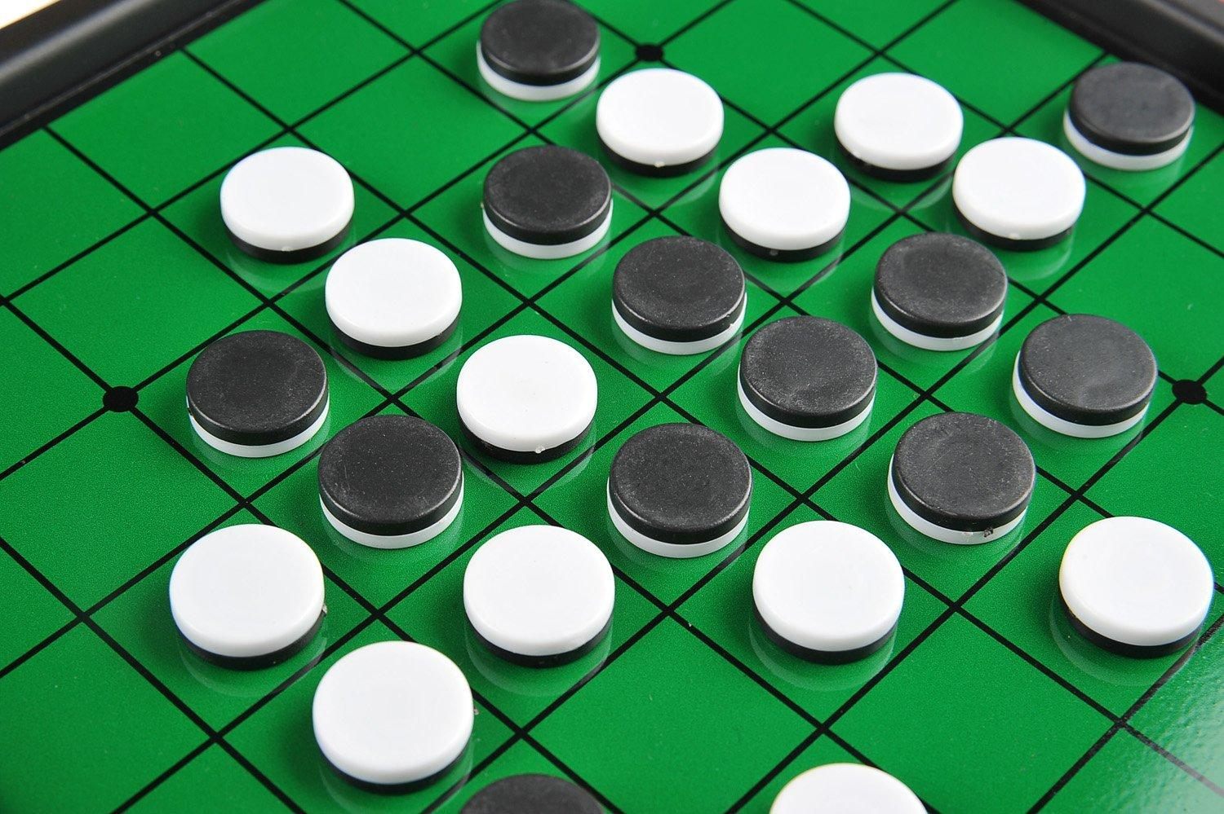
Experience Goal
Similar to Reversi/Othello
Similar mindset
Different gameplay

Slide 5
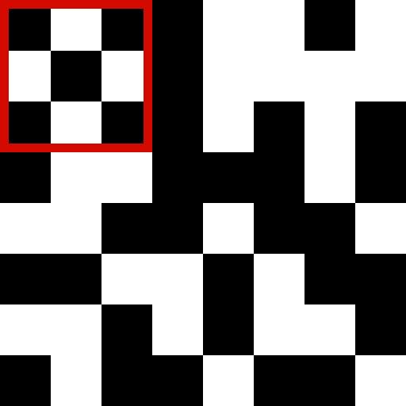
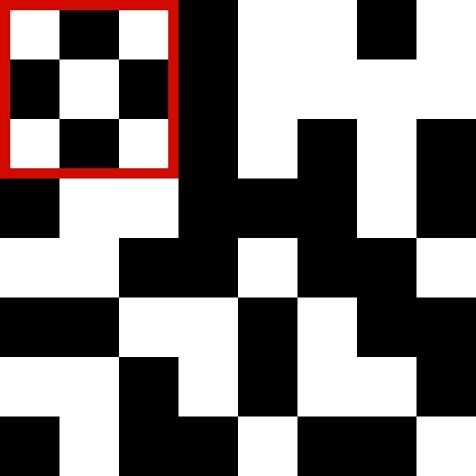
Controls

Slide 6
Play Description
Solve each puzzle in X number of clicks
Each puzzle takes one more click to solve
Each puzzle is randomly generated

Slide 7
Questions?

